Slide 1


SVM
Ha-Rang Kim
25.7.22
ⓒSaebyeol Yu. Saebyeol’s PowerPoint

Slide 2
Table of contents
1
SVM (Linear~Nonlinear)

Slide 3

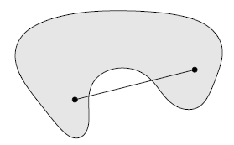













Convex problem
F(x) = convex
Feasible set = convex
$$f\left(αx_{1}+\left(1−α\right)x_{2}\right)≤αf\left(x_{1}\right)+\left(1−α\right)f(x_{2})$$
$$αx_{1}+\left(1−α\right)x_{2}∈Set$$
$$α∈[0, 1]$$
$$y$$
$$α∈[0, 1]$$
$$x_{2}$$
$x_{1}$- $x_{2}$
$$x_{2}$$
$$x_{1}$$
$$x_{2}$$
$$x$$
f’’(x)$≥0$

Slide 4

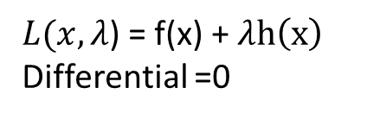





Lagrangian
f’(x)$=0$
min f(x)
s.t. h(X)=0
f’(x)$=0$
$L(x,λ$) = f(x) + $λh\left(x\right)$
Differential =0
f(x)
h(X)=0
Necessary condition
Local minimum x,
$$\left\{\begin{aligned}f^{′}\left(x\right)+λh^{′}\left(x\right)=0 \\ \text{h}\text{(}\text{x}\text{)=0 }\end{aligned}\right\}$$
$∇$f(x) = $−∇λh\left(x\right)$
Minimization point
f’(x) $≠0$
$∇$f(x)

Slide 5
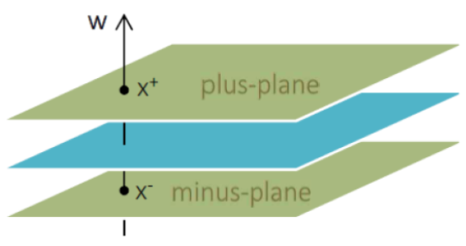
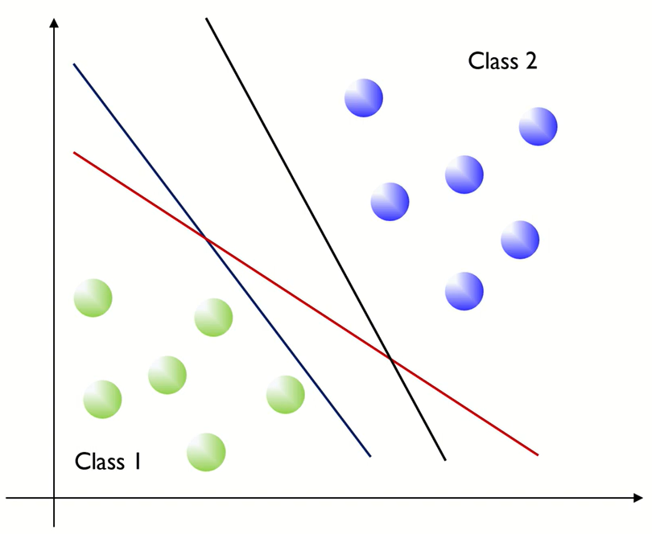
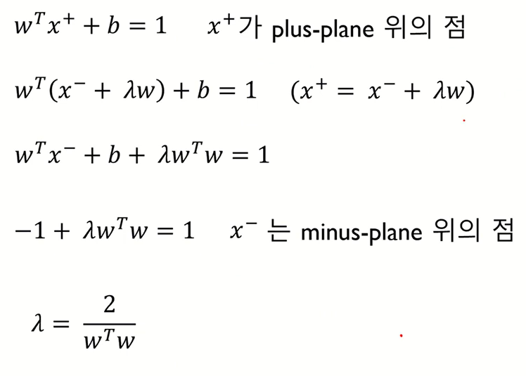
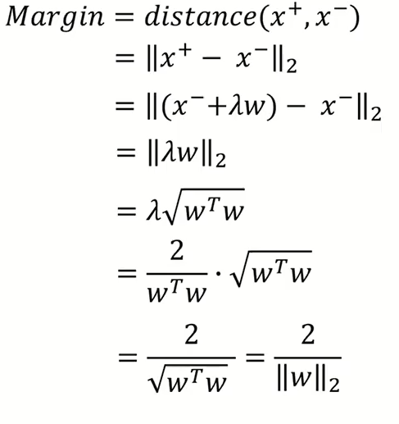
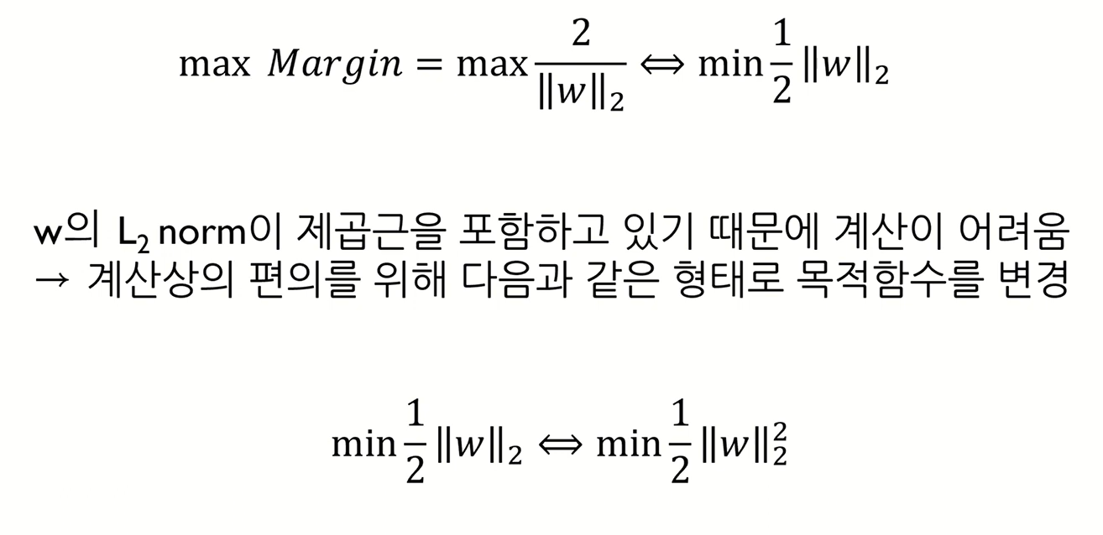



SVM - linear
Generalization ability
$$w^{T}x+b=1$$
$$w^{T}x+b=0$$
$$w^{T}x+b=−1$$

Slide 6
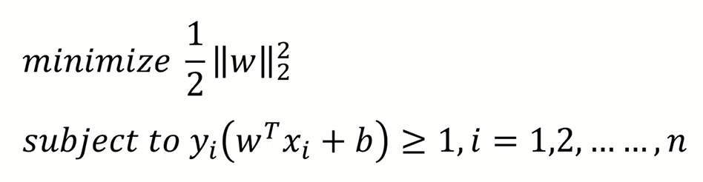
SVM - linear
Decision variable = w, b
QP (quadratic programming) – objective function is quadratic and constraint is linear
-> Convex optimization -> Globally optimal solution

Slide 7
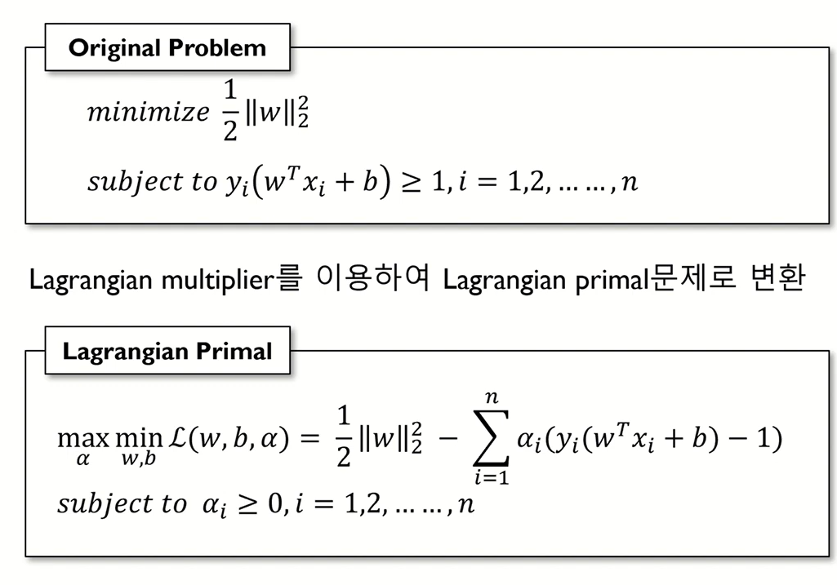
SVM - linear

Slide 8
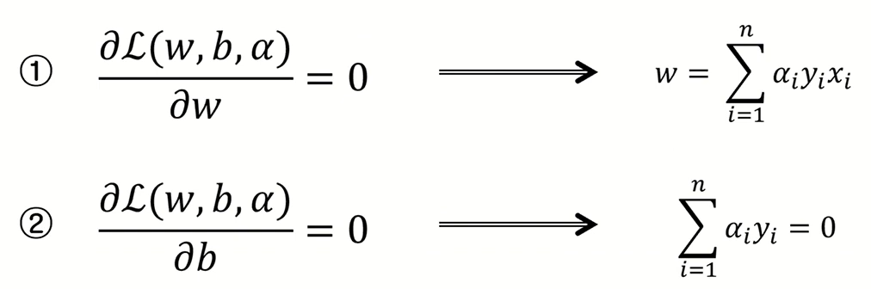
SVM - linear

Slide 9
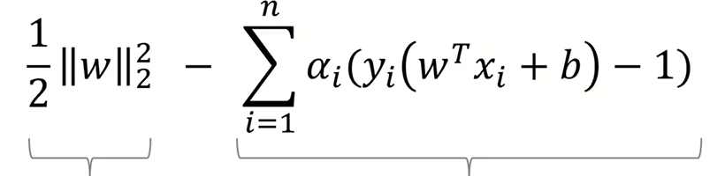
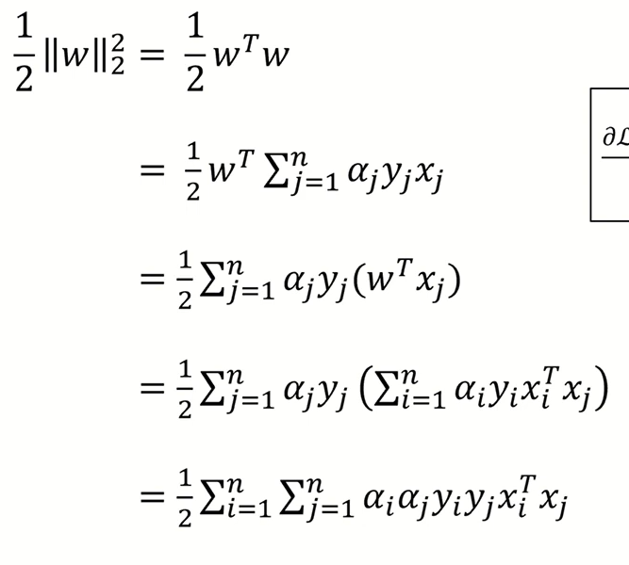
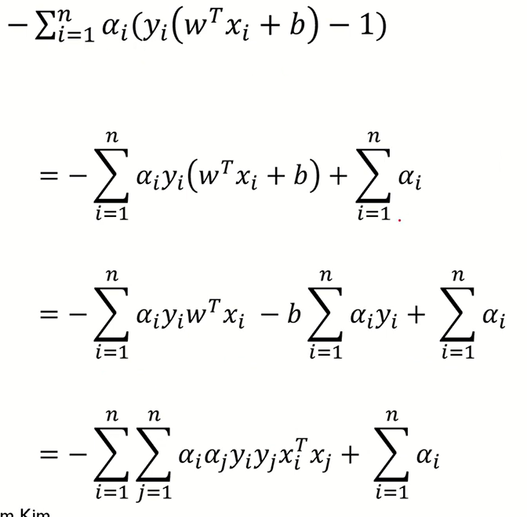
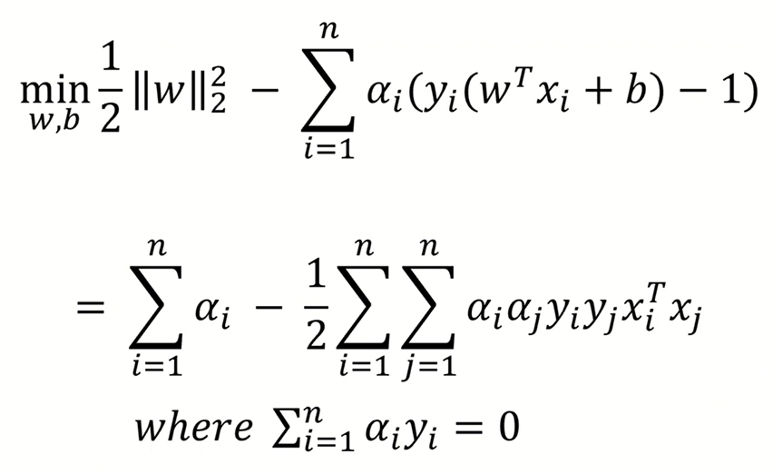
SVM - linear

Slide 10
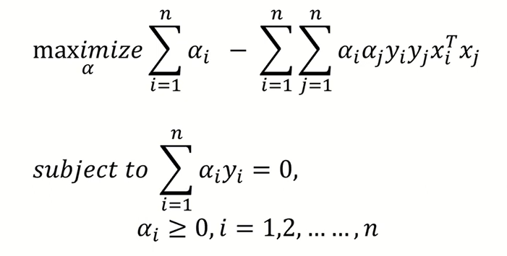
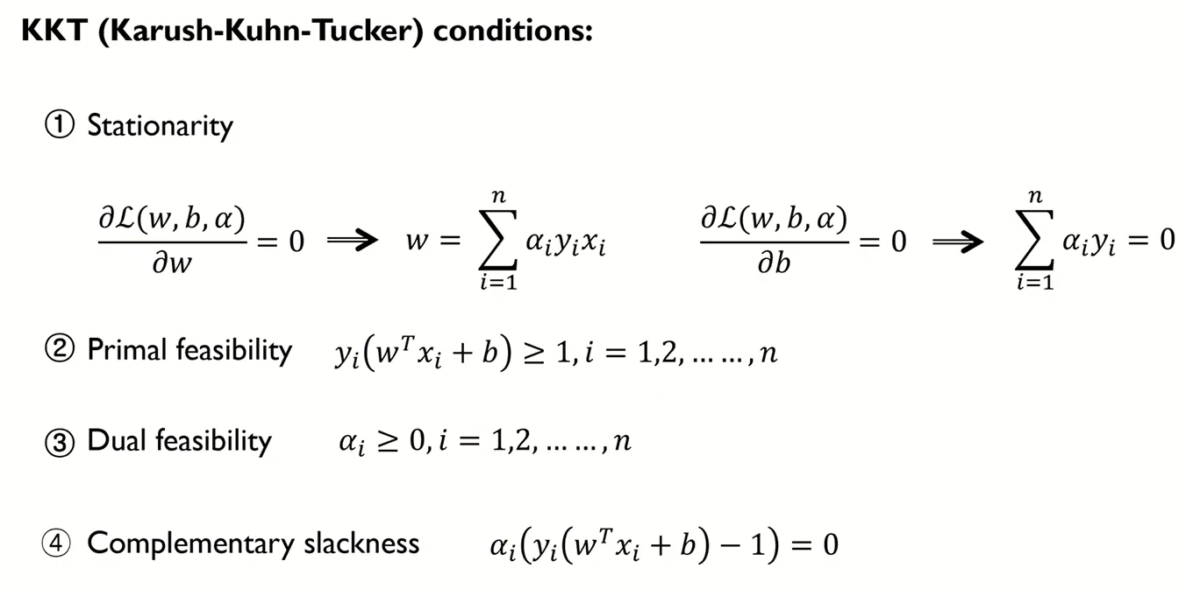
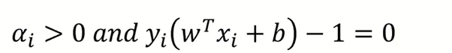

SVM - linear
Dual
Support vector

